Slide 1
Fuzzing File System via Two-Dimensional Input Space Exploration
40th IEEE Symposium on Security & Privacy
MAY 20-22, 2019 AT THE HYATT REGENCY, SAN FRANCISCO, CA
Wen Xu Hyungon Moon† Sanidhya Kashyap Po-Ning Tseng Taesoo Kim
Georgia Institute of Technology
†Ulsan National Institute of Science and Technology
2019.07

Slide 2
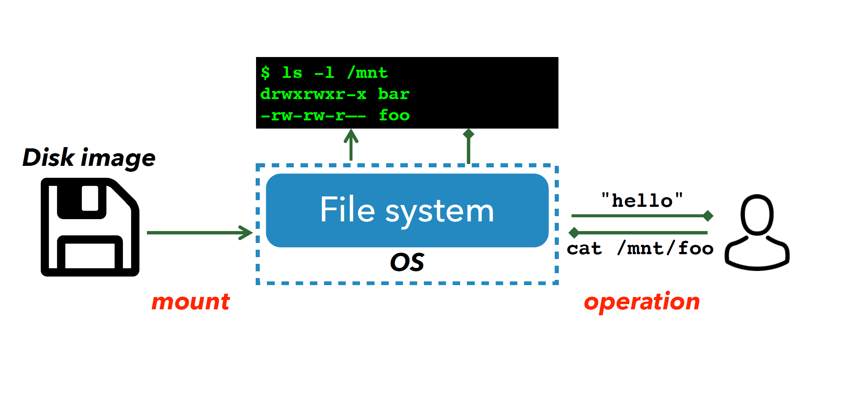
File System

Slide 3
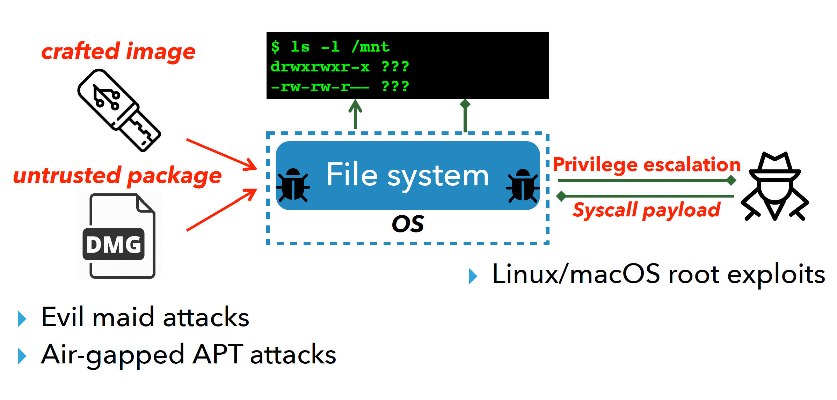
File System Attack

Slide 4
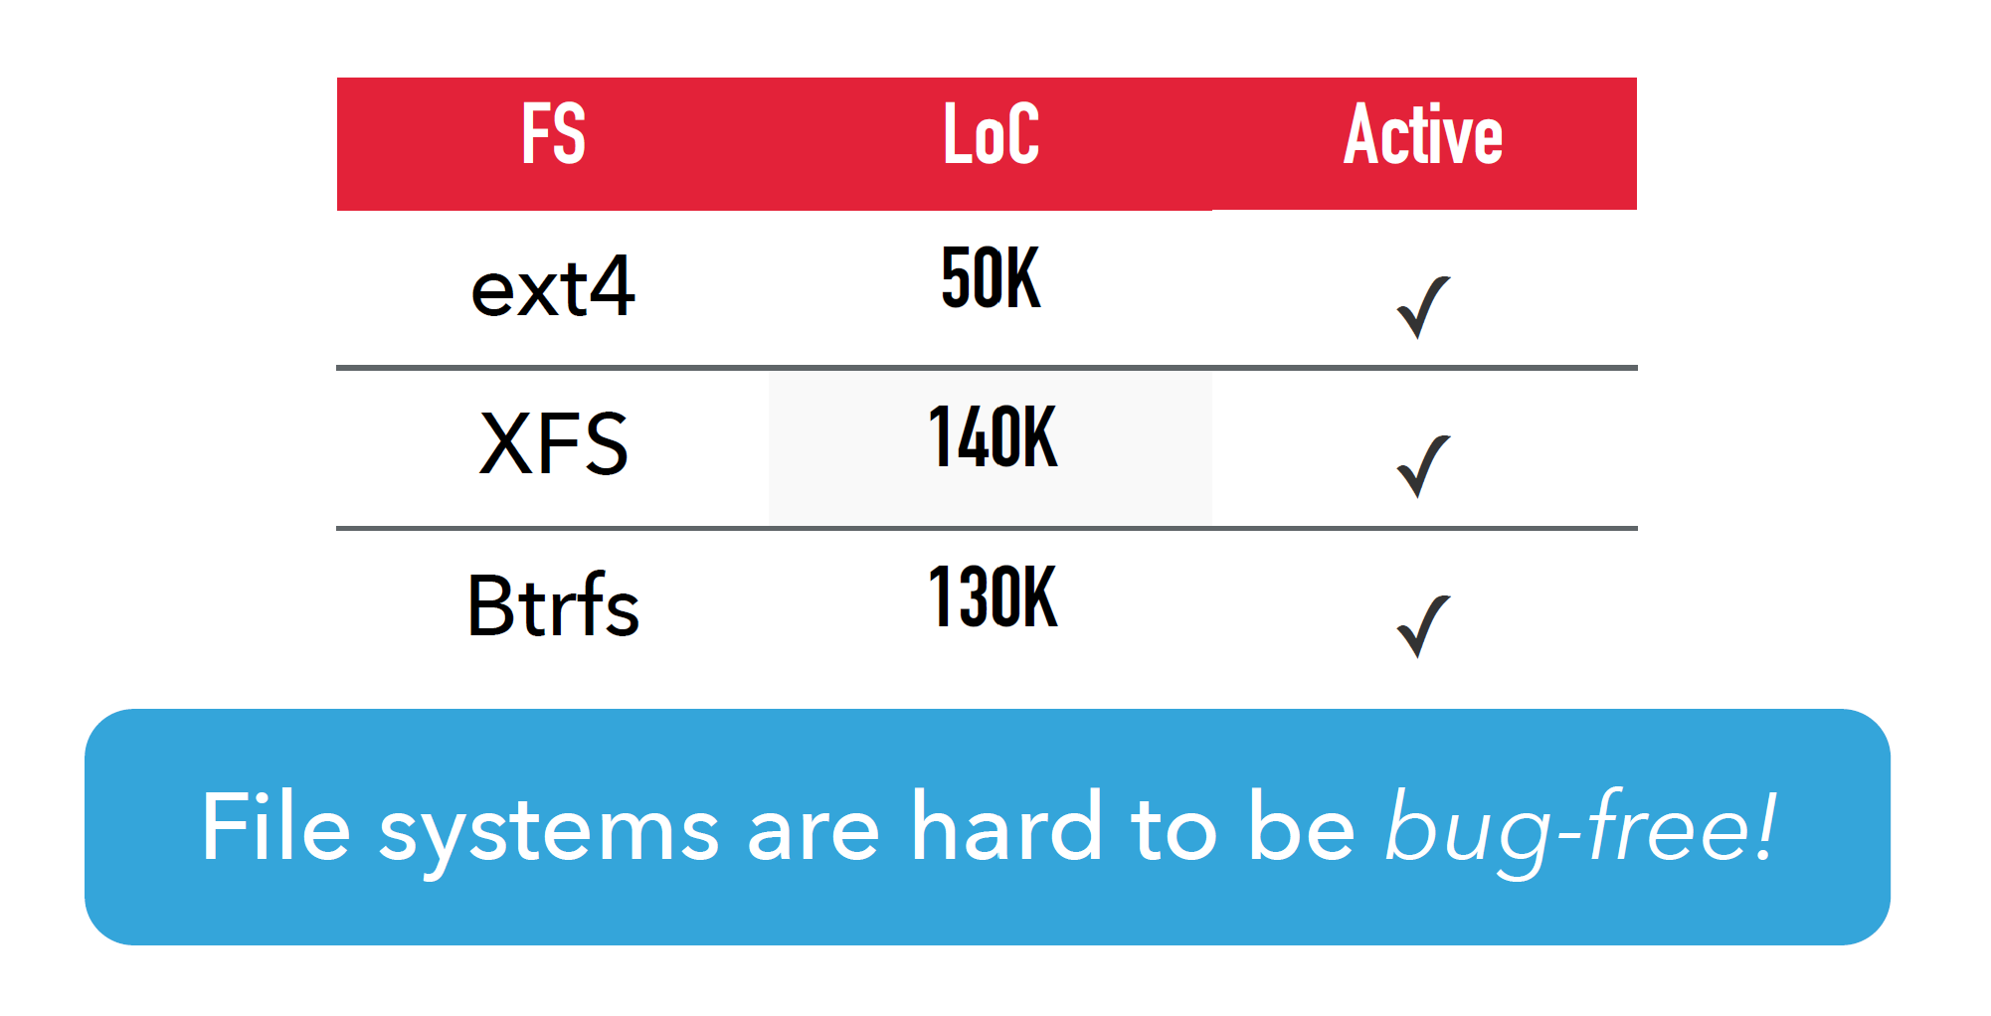
Complexity

Slide 5
Solution - Fuzzing
AFL
Fuzzing images as binary blob
Mount images
Syzkaller
Fuzzing system calls
Execute file operation

Slide 6
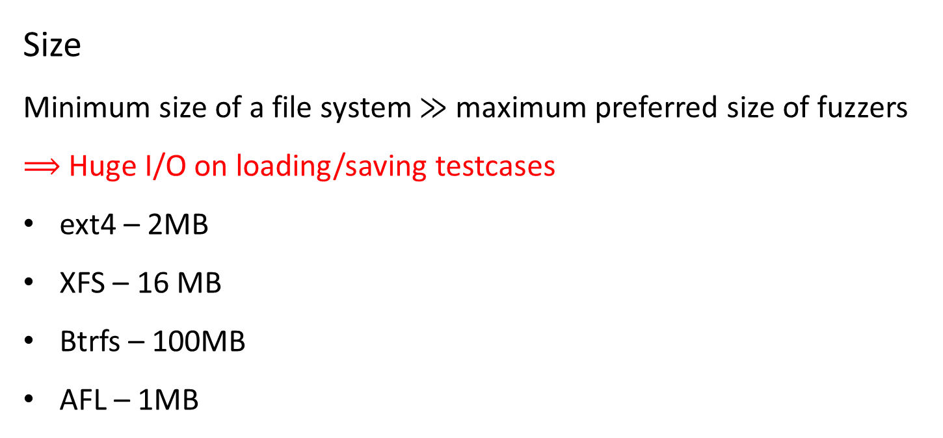
Challenge – Fuzzing Images
Size
Minimum size of a file system ≫ maximum preferred size of fuzzers
$⟹$ Huge I/O on loading/saving testcases
ext4 – 2MB
XFS – 16 MB
Btrfs – 100MB
AFL – 1MB

Slide 7
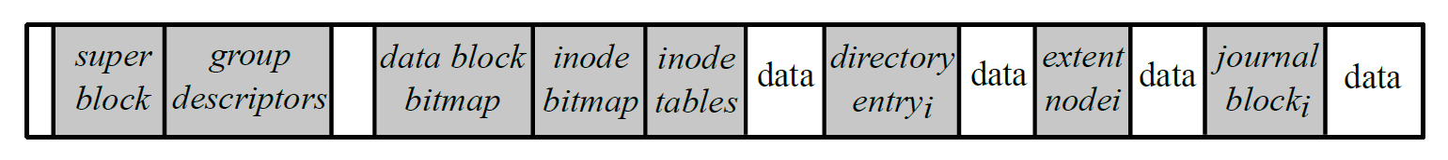
Challenge – Fuzzing Images
Highly structured metadata
Metadata is rarely touched (1% of image size)
OS does not care about data in a file

Slide 8
Challenge – Fuzzing Images
Checksum
Fuzzing the checksum together - inefficient

Slide 9
Challenge – Fuzzing System Call
How to operate
Kernel
Disk
Fuzzer
System Call
File System
File Object
What to operate

Slide 10
Challenge – Fuzzing System Call
open(filename, flag)
read(fd, buffer, int)
write(fb, buffer, int)
mkdir(filename)
rename(filename, filename)
…
Static rules
Semantically correct
Context-unaware
Inter-dependence between file operation and files
System call
File objects
rename(“A”, “B”);
int fd = open(“A”, O_RDWR);
read(fb, buf, 1024);
mkdir(“A”);
int fd = open(“A”, O_RDWR);

Slide 11
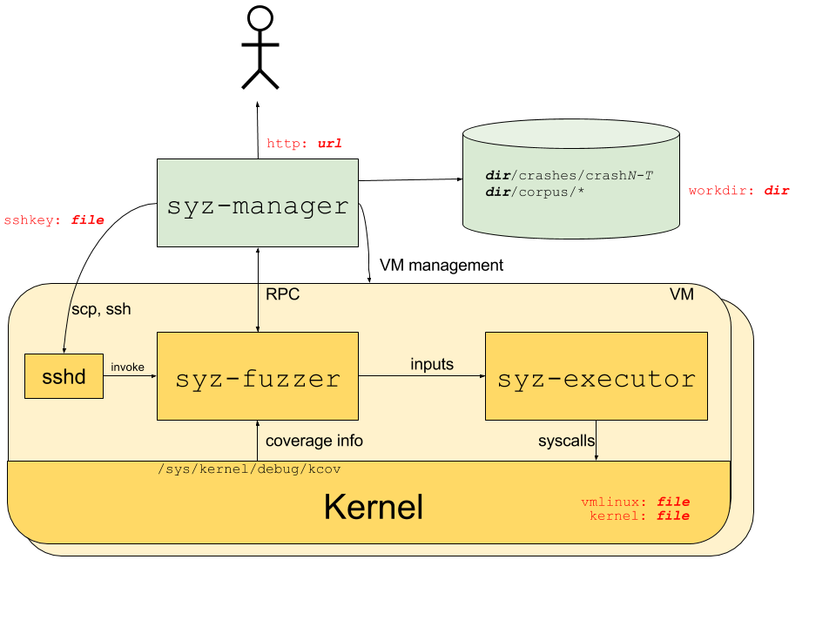
Challenge – Fuzzing Efficiency with VM
Never reboot until a VM crashes
Due to the cost of reboot or reverting from snapshot
A bug may accumulate the impact of thousands of syscalls
Aging OS state
Unstable executions
Hard to reproduce bugs

Slide 12
Challenge – Two-Dimension Input
Jointly fuzzing images and system calls

Slide 13
What is JANUS’s solution?

Slide 14
Solution – Fuzzing Images
Less frequent I/O when mutating image
Extract and mutate metadata only (1%)
Fix checksum
Image parser
Image mutator
Eight filesystem, user space utilities – mkfs, fsck
Metadata
AFL
Re-calculate checksum

Slide 15
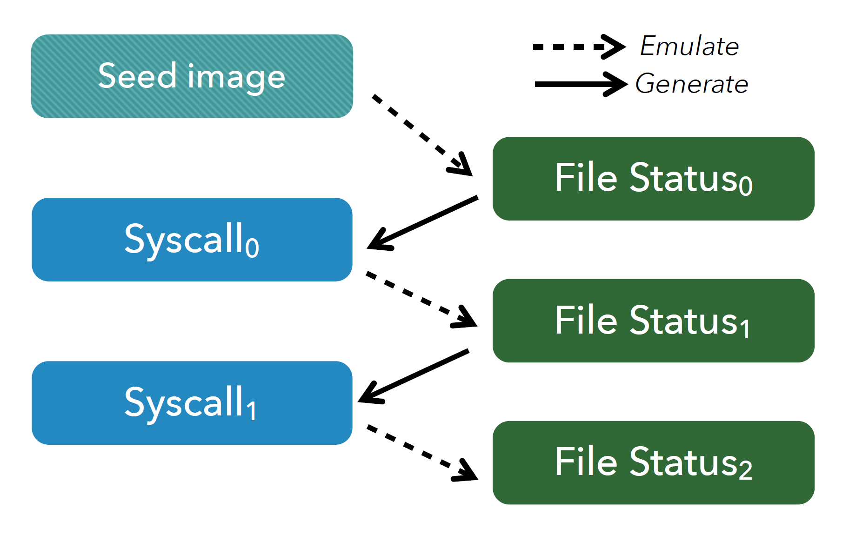
Solution – Fuzzing System Calls
Context-aware syscall generation
Image inspector
File object path
File object type
File object extend attribute
System call fuzzer

Slide 16
Solution – Fuzzing Efficiency with VM
Library OS – Linux Kernel Library
Use Linux kernel as a linkable library, so that the non-static functions from the kernel can be called from some external program.
User-space executor linked with LKL
Fork a new instance for each test case
Invoke LKL system call to mount an image
Invoke the generated system calls (file operations)
Re-initialize the OS states within milliseconds

Slide 17
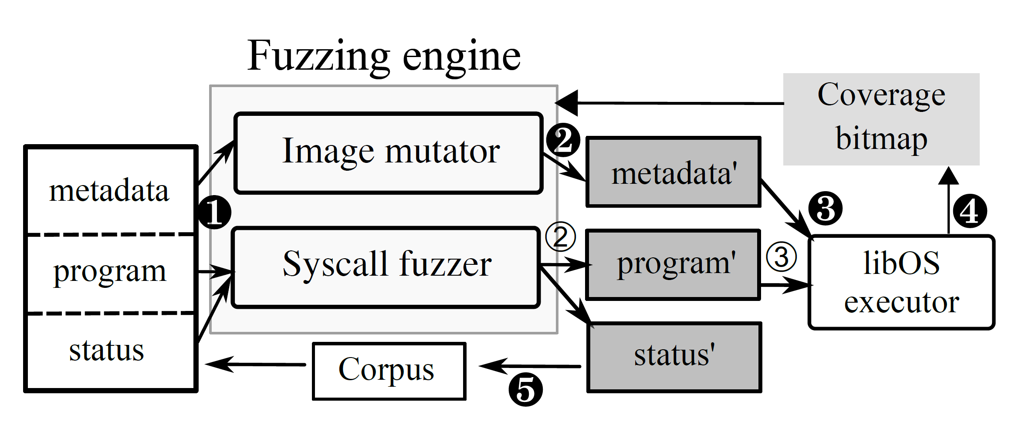
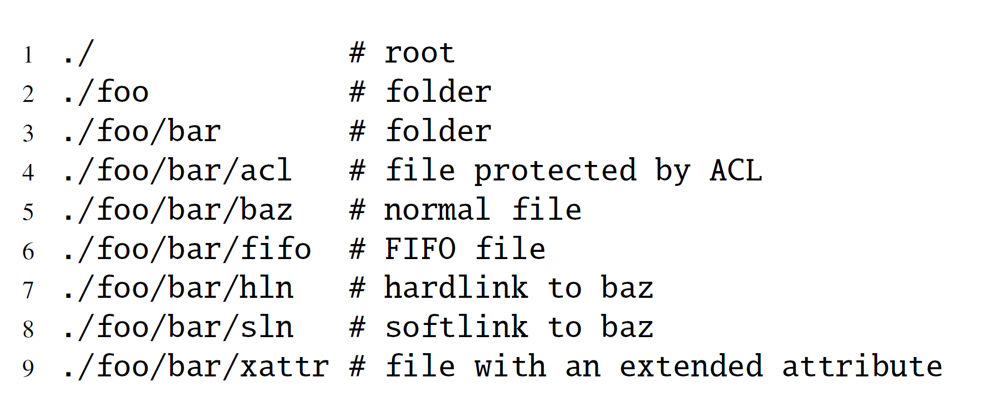
Solution – Two-Dimension Input
Initialize corpus
Seed image metadata
Starting program
File object status

Slide 18
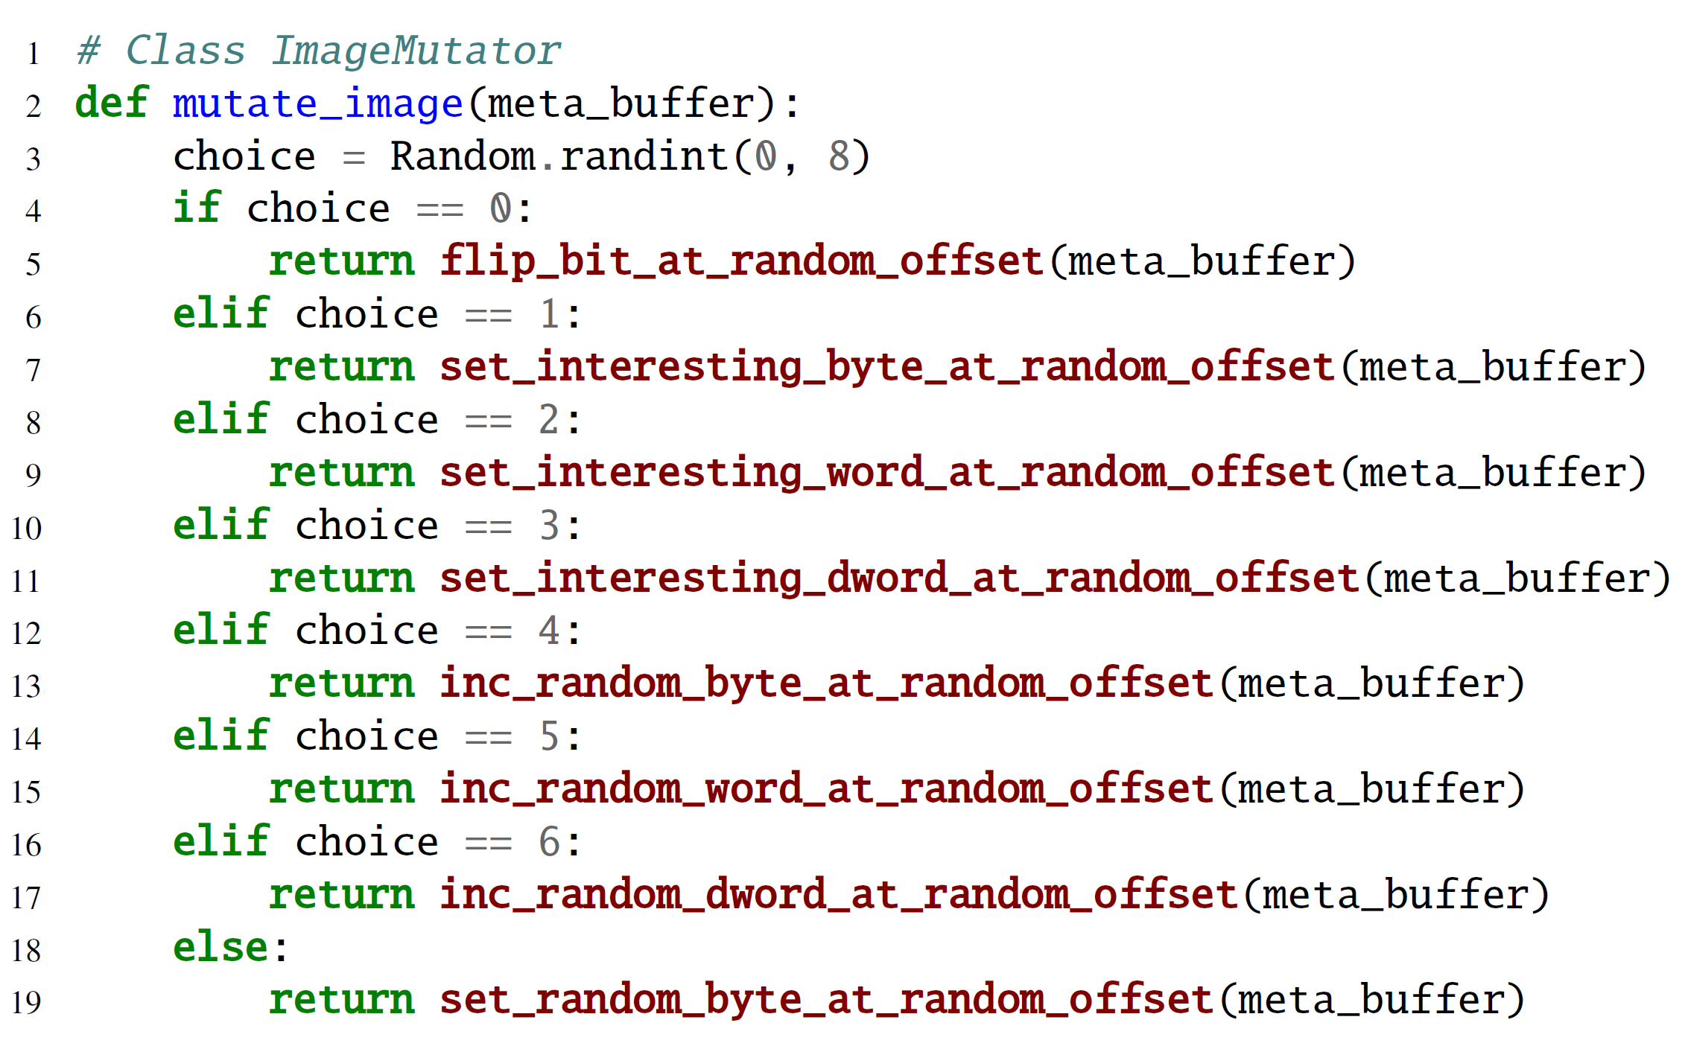
Solution – Two-Dimension Input
Mutating image
Keep the program intact
Until no more coverage for certain rounds

Slide 19
Solution – Two-Dimension Input
Mutating system calls
Keep the metadata intact
(1) Syscall mutation
Until no more coverage for rounds
(2) Syscall generation
Until no more coverage for rounds
Status
File descriptor
Path
Extended attribute

Slide 20
Solution – Two-Dimension Input
Summary
Mutate image for rounds
Mutate argument types for rounds
Append new syscalls for rounds
If new code covered, add to corpus

Slide 21
Evaluation
How effective in discovering previously unknown bugs in file systems?
Found more bug than Syzkaller
90 bugs, 62 previously unknown, 36 in wildly used FS – ext4, XFS, Btrfs
32 CVEs assigned
25% bugs – mount only a corrupted image
80% bugs – Need to invoke three or more system calls
Most bugs – mounting a corrupted image followed by particular syscalls

Slide 22
Evaluation
How effective in exploring images?
Syzkaller’s image fuzzing support
Fuzzing only image
Syzkaller considers only the non-zero chunks as important part
Miss metadata block
Include inessential data blocks
Not fixing checksum
Result – 4.17× coverage

Slide 23
Evaluation
2. How effective in exploring system calls?
Syzkaller’s system call fuzzer
Fuzzing only system call
Context-aware system call generation
Result – 2.24× coverage

Slide 24
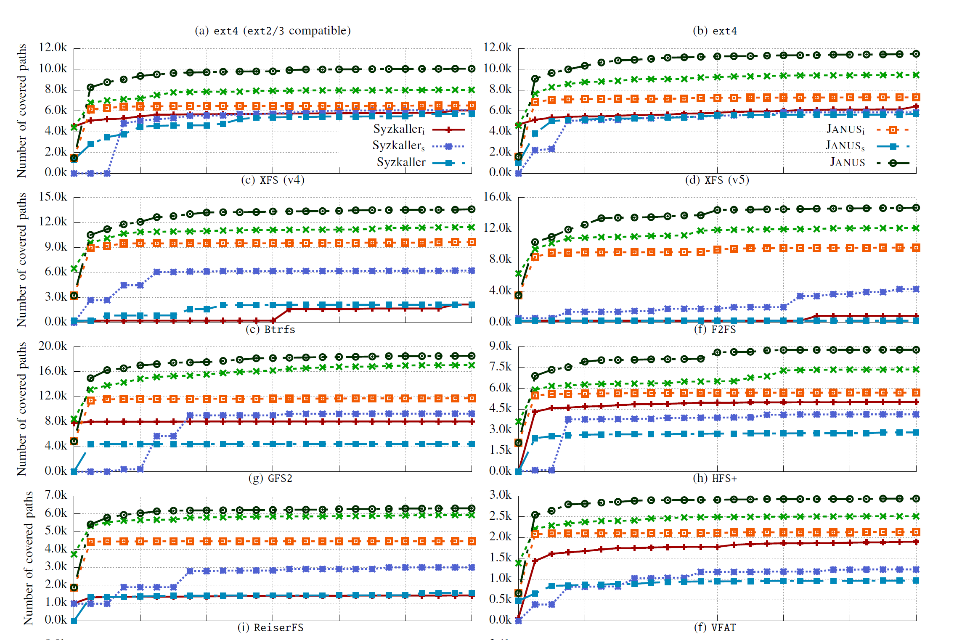
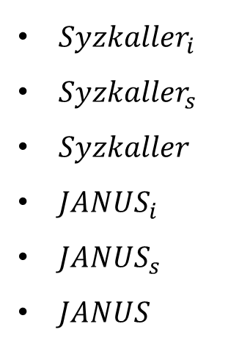
Evaluation
How effective in exploring two-dimensional input space?
${Syzkaller}_{i}$
${Syzkaller}_{s}$
$Syzkaller$
${JANUS}_{i}$
${JANUS}_{s}$
$JANUS$

Slide 25
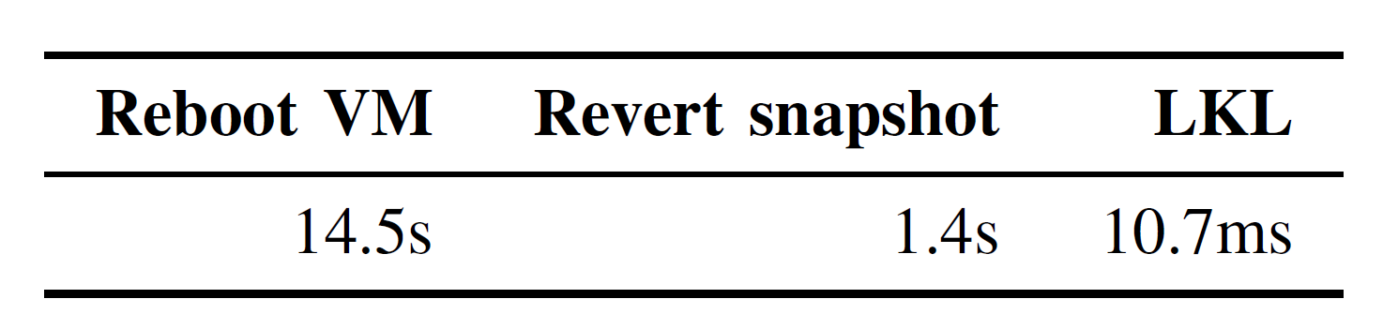
Evaluation
How effective in reproducing crashes?
Syzkaller fails to reproduce any of its found crashes
JANUS can reproduce 95% of its found crashes
Btrfs - non-deterministic execution
Overhead of VM & LKL

Slide 26
Evaluation
What else can JANUS contribute to?
Malicious image sample
Extend security checks into the user-space tool for hardening - fsck

Slide 27
Limitations
Minimal PoC generator – brute force
Revert every mutated byte
Remove every invoked file operation
Check whether the kernel still crashes at the expected location
Multi-threaded bugs?

Slide 28
Thanks.

